Slide 1
Predicting Dispatch Response Time in Montgomery County (2025)
A Statistical Analysis of 2025 Crime & Dispatch Data
DATA 205
Lucjan Szulim

Slide 2
Why this matters?
When you call 911 in Montgomery County, how long until an officer arrives? And does it depend on more than just the emergency?
Priority level, geography, and time of day predict response time - but not as much as you might expect
Here is what the data shows

Slide 3
How Does Montgomery County Classify 911 Calls?
Priority | Label | Description | Example
P0 | Emergency | Immediate threat to life | Active shooting, cardiac arrest
P1 | High | Serious incident in progress | Assault, robbery in progress
P2 | Medium | Urgent but not life-threatening | Fight, suspicious person
P3 | Low | Non-urgent incident | Noise complaint, minor dispute
P4 | Standard | Administrative or low-priority | Parking violation, cold report
Priority is assigned by the dispatcher based on caller information at time of call; it is the system's best estimate of urgency before an officer arrives.

Slide 4
Project Overview
Montgomery County Open Data Portal - Crime Reports (59,811 records) & Police Dispatch Incidents (252,157 records), filtered to 2025
Goals:
Understand what predicts dispatch response time
Link crime type to dispatch behavior
Build a predictive model of response time

Slide 5
Tools used
Python (pandas, numpy, matplotlib, seaborn)
scipy for statistical tests
statsmodels for OLS regression
scikit-learn for Random Forest
GitHub to store and manage the project
Google Colab as the development environment
Data Montgomery open data portal

Slide 6
Data Pipeline & Cleaning Decisions
Four notebooks: Ingestion → EDA → Statistical Tests → Modeling
Key decisions
Response times > 120 minutes removed (415 rows, 0.16%), response time greater than 2 hours is not the standard for active emergencies
Response times < 1 min excluded, not true dispatches
59,011 calls with no arrival recorded flagged separately, not dropped
20+ engineered features: time of day, priority labels, incident categories, geographic joins
Final analytic populations: 192,731 dispatch calls with recorded response times

Slide 7
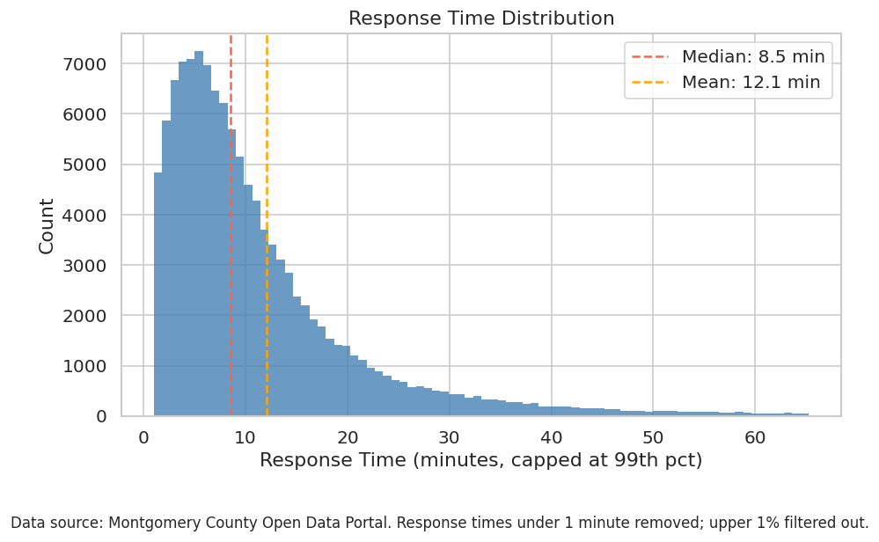
Descriptive Statistics
Dispatch: 252,157 raw → 192,731 analytic | Median RT: 7.95 min | Mean: 11.29 min | 5 priority levels | 6 districts
Crime: 59,811 records | 4 broad categories | 49 NIBRS codes | 10 specific incident types analyzed
Response time distribution: right-skewed, log-normal shape
Priority breakdown: P1-High is the most common (94,821 calls)
Most common incident types: Suspicious, Traffic, Theft/Burglary, Other

Slide 8
Six Hypothesis Tests, One Clear Winner
Question | Test | Key Result
Does RT differ by priority? | Kruskal-Wallis + Dunn | ε²=0.104, medium effect
Does RT differ by incident type? | Kruskal-Wallis + Dunn | ε²=0.019, small effect
Does weekend affect RT? | Mann-Whitney U | r=-0.053, negligible
Does type change predict duration? | Mann-Whitney U | r=0.186, small effect
Does crime rate predict RT? | Spearman | ρ=-0.086, no relationship
Does time of day affect RT? | Kruskal-Wallis + Dunn | ε²=0.026, small effect
Non-parametric tests used throughout since response time is right-skewed. Effect sizes reported alongside p-values because with n=192,731, everything is statistically significant.
Priority is the only predictor with a medium effect size, everything else is small or negligible. This consistency across six different tests and two modeling approaches makes it the most robust finding in the project.

Slide 9
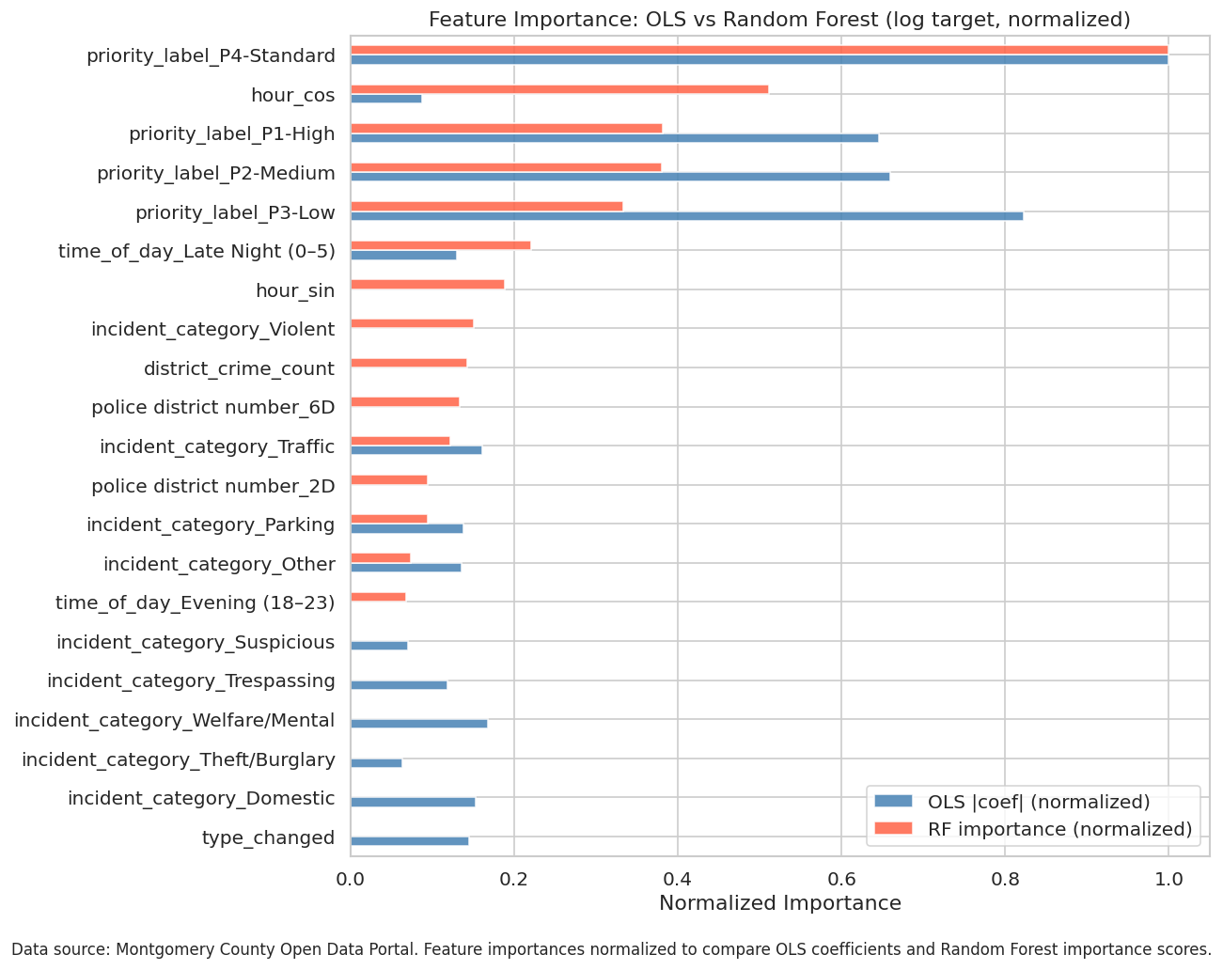
Models
Models: OLS regression + Random Forest on both raw and log-transformed response time
Best model: Random Forest (log target) - R²= 0.124, Mean Absolute Error = 6.80 min
"Why is R² only 0.124 if priority is so dominant?" - Priority tells us the expected wait, but the actual wait on any given call depends on where officers are at that moment, data we do not have

Slide 10
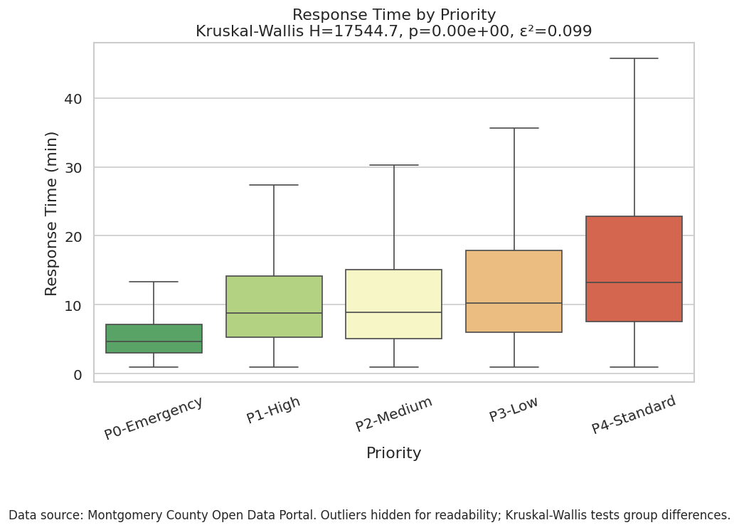
The Higher the Priority, The Faster the Response
P0 median = 4.6 min vs. P4 median = 13.6 min, 3× difference
Kruskal-Wallis H = 2,911, ε² = 0.104 (medium effect)

Slide 11
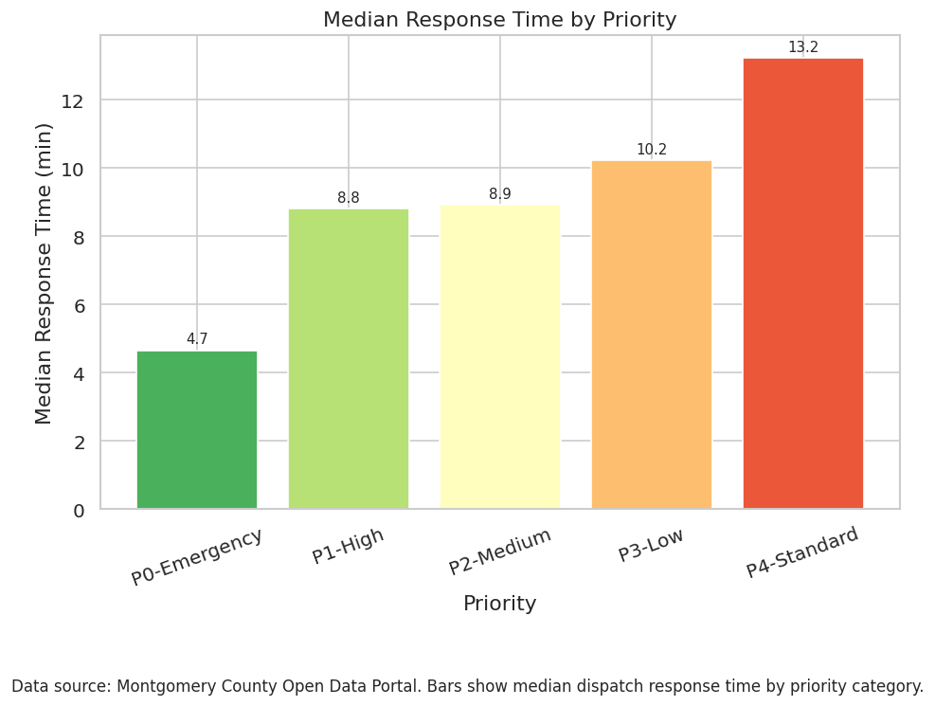
A Surprising Gap in the Priority System
P1-High and P2-Medium are statistically indistinguishable (Dunn post-hoc p=1.0)
Two separate priority levels produce identical operational outcomes, worth reviewing dispatch protocol

Slide 12
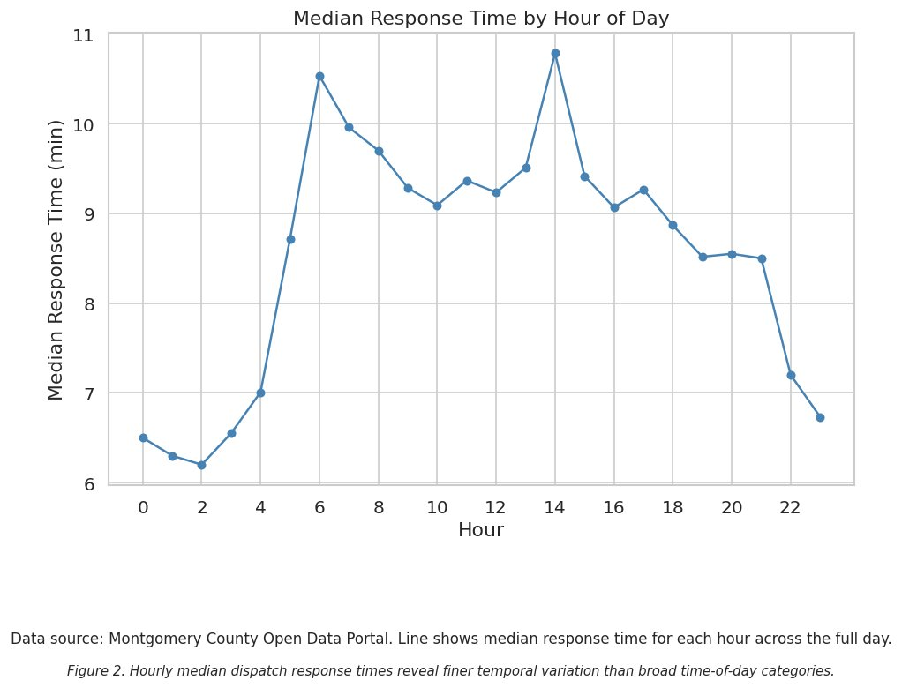
Fewer Calls = Faster Response
Late Night (midnight–5am) median 6.5 min vs. daytime ~9.8 min
Lower concurrent call volume, not increased staffing

Slide 13
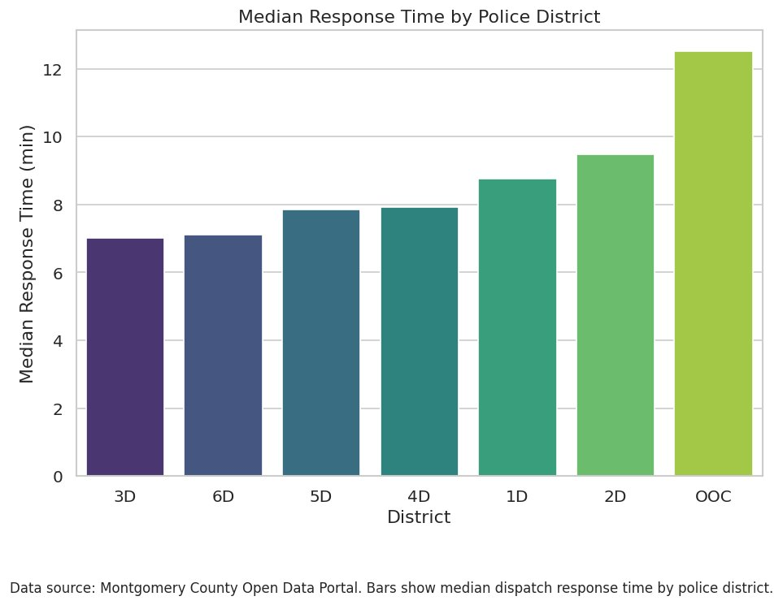
Geography Shapes Your Wait Time
3D; Silver Spring and 6D; Gaithersburg/Montgomery Village fastest (~7.0 min).
2D; Bethesda slowest (~9.5 min), 2.5 min gap persists after controlling for priority

Slide 14
Weekends Are Not Slower, The Data Says So
Weekday median: 8.85 min
Weekend median: 8.18 min
Difference: 0.67 min
Mann-Whitney U Test with p<0.001 but r=-0.053 (negligible effect)
Statistically significant does not mean meaningful, this is why effect sizes matter

Slide 15
Reflection
Challenging:
Column name inconsistencies across raw files caused repeated KeyErrors throughout the pipeline
23% of dispatch records had no arrival recorded - required careful population documentation
Multicollinearity between district dummies and crime count required structural model changes
Balancing the ingestion/EDA notebook separation mid-project
Rewarding:
The P1 vs P2 finding was unexpected and operationally meaningful
Watching the OLS residuals improve dramatically with log transformation
Building a clean, reproducible data pipeline from messy open data
What I would change:
Establish the notebook structure and clean file naming conventions before writing any code
Add beat and PRA-level geographic analysis from the start - district level had too few units (n=6) for meaningful spatial tests
Collect a full year of data rather than filtering to 2025 mid-year to capture seasonal patterns

Slide 16
Limitations
Response time missing for 23% of dispatch records (no-arrival population)
Only 6 districts - low power for geographic tests
No real-time operational data (officer location, concurrent calls)
2025 only - seasonal patterns not fully captured
OLS condition number elevated despite VIFs < 10

Slide 17
Next steps
For the product: Interactive dashboard - response time by district, priority filter, hour-of-day animation
Policy recommendation: The P1/P2 finding warrants review - if two priority levels produce identical response times, the classification system may need refinement
Investigate why response time is missing for 23% of dispatch records

Slide 18
Conclusion
Priority is the dominant predictor - by a wide margin
District, time of day, and incident category have small but real effects
Weekend has no practical significance

Slide 19
Acknowledgements
Professor Alraee
Professor Perine
Professor Park
Data science classmates and Early college cohort
Classmates who provided feedback
Data Montgomery open data portal

Slide 20
Questions?
https://github.com/Garfieldslard/Crime-Analysis
https://data.montgomerycountymd.gov/Public-Safety/Crime/icn6-v9z3/about_data
https://data.montgomerycountymd.gov/Public-Safety/Police-Dispatched-Incidents/98cc-bc7d/about_data

